Slide 1
Bro’s Before Flows
Network Data Acquisition for Incident Response
June 2nd 2016
Troy Wojewoda
Cyber Security Analyst

Slide 2

$ id
Currently leads the incident response team at HII-NNS with a focus on intel processing, IOC hunting, malware analysis and custom tool development.
In the information security industry for over 10 years in areas such as application and system administration, network intrusion detection, wireless security, host and network digital forensics and incident response.
Enjoys camping/hiking in the mountains, spending time with family and home brewing.

Slide 3
Level Set Expectations
Expectations:
High-level discussion on various network capture data points
Vendor agnostic
All networks are different, “one-size” does not fit all
Endpoint data not discussed…for now
Quest to find the network acquisition “Sweet Spot”
Many tools and technologies available – tailor to your network
Time is our enemy – data loss over time
Context, context, context
Disclaimer
The views and opinions expressed in the presentation are solely my own and do not express the views or opinions of my employer
This talk is not intended to bash or deface the value of IPFIX/Netflow

Slide 4
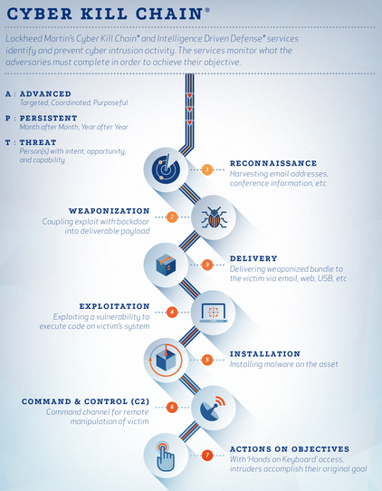
It’s 5am, do you know where your IR plan is?
Something alerted the IR team there’s a problem
External notification
High fidelity signature
User reported suspicious activity
What do you know about the initial incident?
Can you find the initial incident?
Initial vector?
What devices triggered an event?
What devices logged the event(s)?
Can you fully identify the key Cyber Kill Chain ® components:
Delivery, Exploitation, Installation, C2, A-Objectives
Source: http://www.lockheedmartin.com/content/dam/lockheed/data/isgs/photo/isgs-cyber-kill-chain-infographic.png
Preparation
Identification
Containment
Eradication
Recovery
Lessons Learned
Incident Response Phases

Slide 5
Where Do I Start?
FPC
Bro
Application Proxy/Gateway logs (tangential)
IPFIX/Netflow
IDS/IPS
Firewall Logs

Slide 6
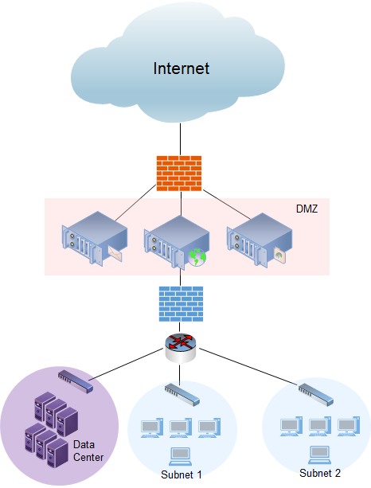
Position and Acquisition
Identify essential Egress/Ingress Points
FPC
Bro
Netflow
IDS
Centralized logging

Slide 7
Full Packet Capture
FPC
Full picture of what happened over the network
See everything, know everything (-v encryption/obfuscation)
Can be used to test IDS and other signatures
Open Source
https://www.sans.org/reading-room/whitepapers/logging/custom-full-packet-capture-system-34177
Google Stenographer (https://github.com/google/stenographer)
Commercial Solutions
BlueCoat Security Analytics (https://www.bluecoat.com/products-and-solutions/security-analytics-and-incident-response)
NetworkMiner (http://www.netresec.com) – also, a free version
RSA NetWitess (https://www.emc.com/collateral/data-sheet/rsa-netwitness-investigator.pdf)
Splunk App for Stream (https://splunkbase.splunk.com/app/1809/)

Slide 8

Bro IDS
Network Intrusion Detection System
Network forensic data
Meta-data all the things
Scripting language
adapted for network traffic analysis
Several frameworks at the foundation
Source: https://www.bro.org/

Slide 9
Proxies and Gateways
Application Proxy/Gateway logs (tangential)
Rich context around specific network protocols
HTTP, SMTP, FTP, etc
Leverage authentication protocols
Control who talks to what
Categorization Control
Web: site categorization
Email: spam
Inspection and Protection
Dynamic code inspection
AV scanning
Great place for in-line protection
Many, many vendors to choose from

Slide 10
IPFIX/Netflow
Cisco Netflow Version 9
IETF standard known as IP Flow Information Export (IPFIX)
Exporter/Collector architecture
Exporter: Routers and Layer-3 switches
Collector: Centralized server that receives exporter data
Exporter outputs flow record when session is over
Configurable, can have fixed intervals
Common record data
Src/Dst IP Addresses
IP Protocol
Src/Dst Layer-4 Port Numbers
Number of Bytes and Packets observed
TCP Flags Observed (if applicable)
Next-Hop address (layer-3 routing)
Autonomous System (AS) number of observed IP addresses
Much more…

Slide 11
Intrusion Detection/Prevention Systems
Designed to detect and/or prevent malicious network traffic
Traditionally signature-based, pattern recognition
Newer technologies are behavioral based, coupled with signatures
Signatures can be written to work at multiple layers of the OSI-model
Open Source Solutions
Snort
Suricata
Bro
Security Onion (aka all of the above)
ROCK NSM (Response Operation Collection Kit) http://rocknsm.io
Commercial Solutions
Tons in this space
Behavioral Solutions becoming mainstream

Slide 12
Firewalls
Many flavors of choice
Packet Filtering
Stateful
Application Proxy
Next-Gen ;-)
Allowed/Denied traffic (logs)
IP Address
Port
Protocol
Allowed/Dropped

Slide 13
Scenario 1: Ransomware Campaign
Phishing emails with malicious word documents (mal macros)
Detonation of word document calls out to some domains
www.oracle.com (dns, http GET /)
pompe-distribution[.]com (GET jpg) – or is it??

Slide 14
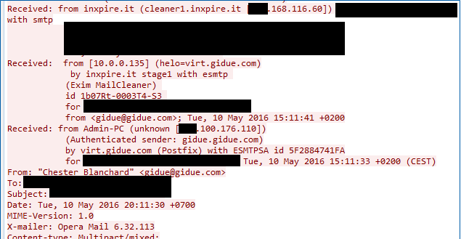
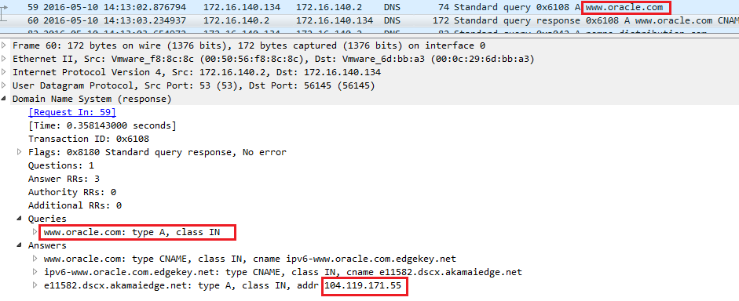
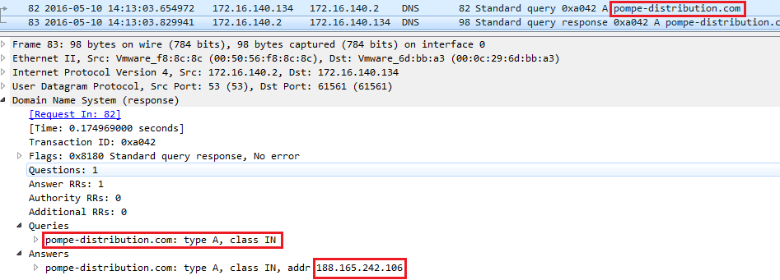
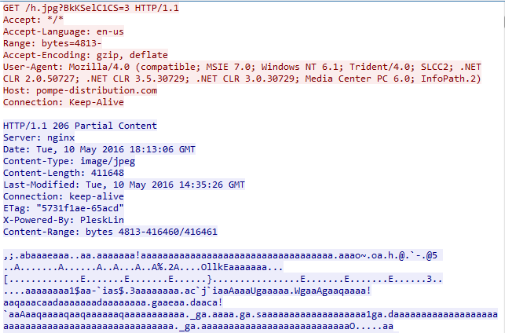
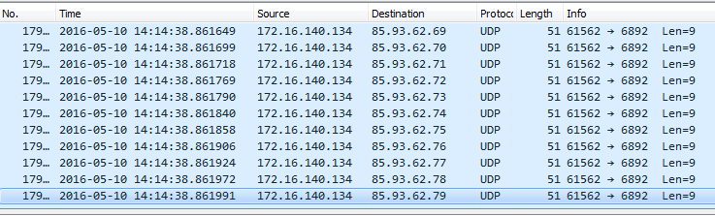
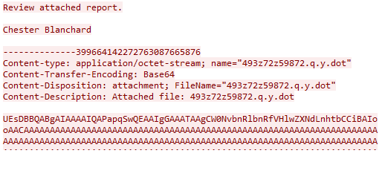
Scenario 1: Full Packet Capture

Slide 15
Scenario 1: Bro
smtp.log
files.log
dns.log
http.log
conn.log

Slide 16
Scenario 1: Bro (smtp, files logs)
1462886008.279905 C5ouiO24QUYz30Xe8b xxx.xxx.xxx.21 45342 xxx.xxx.xxx.71 25 <gidue@gidue.com> Tue, 10 May 2016 20:11:30 +0700 "Chester Blanchard" <gidue@gidue.com> <20160510131133.5F2884741FA@virt.gidue.com> Chester Blanchard xxx.168.116.60,10.0.0.135,xxx.100.176.110 Opera Mail 6.32.113 FaDVWx4yFrK1oXaLj9,F5z29J21T6RkiBkQYd
smtp.log
May 10 09:13:28 F5z29J21T6RkiBkQYd xxx.xxx.xxx.71 xxx.xxx.xxx.21 C5ouiO24QUYz30Xe8b SMTP 3 SHA1,MD5,DATA_EVENT application/vnd.openxmlformats-officedocument.wordprocessingml.document 493z72z59872.q.y.dot 227385 bce1518952823dbd772d04bd3bbd6498 ec8b965739169b11c7db3a2dccbea6687b8d9476
files.log

Slide 17
Scenario 1: Bro (dns, conn logs)
1462903982.876794 CSfVmG1DYRmTYPkfB8 172.16.140.134 56145 172.16.140.2 53 udp 24840 www.oracle.com ipv6-www.oracle.com.edgekey.net,e11582.dscx.akamaiedge.net,104.119.171.55 5.000000,5.000000,5.000000
1462903983.654972 CU0xL93k2TxtBtJ1Gc 172.16.140.134 61561 172.16.140.2 53 udp 41026 pompe-distribution.com 188.165.242.106 5.000000
dns.log
1462903983.235529 CRgU5K1zEjs97VD90d 172.16.140.134 49159 104.119.171.55 80 tcp http 0.268109 668 12111 RSTO -0 ShADadR 8 1000 13 12635
1462903983.843758 C5oKx53ZqYePW3r0Lf 172.16.140.134 49160 188.165.242.106 80 tcp http 27.938476 356 411941 RSTO -0 ShADadR 110 4768 303 424065
conn.log

Slide 18
Scenario 1: Bro (http, files logs)
1462903983.291275 CRgU5K1zEjs97VD90d 172.16.140.134 49159 104.119.171.55 80 1 GET www.oracle.com / - Mozilla/4.0 (compatible; MSIE 7.0; Windows NT 6.1; Trident/4.0; SLCC2; .NET CLR 2.0.50727; .NET CLR 3.5.30729; .NET CLR 3.0.30729; Media Center PC 6.0; InfoPath.2) 0 0 301 Moved Permanently - - - (empty) - - - - - - -
1462903983.351576 CRgU5K1zEjs97VD90d 172.16.140.134 49159 104.119.171.55 80 2 GET www.oracle.com /index.html - Mozilla/4.0 (compatible; MSIE 7.0; Windows NT 6.1; Trident/4.0; SLCC2; .NET CLR 2.0.50727; .NET CLR 3.5.30729; .NET CLR 3.0.30729; Media Center PC 6.0; InfoPath.2) 0 0 206 Partial Content - - - (empty) - - - - - - -
1462903983.891293 C5oKx53ZqYePW3r0Lf 172.16.140.134 49160 188.165.242.106 80 1 GET pompe-distribution.com /h.jpg?BkKSelC1CS=3 - Mozilla/4.0 (compatible; MSIE 7.0; Windows NT 6.1; Trident/4.0; SLCC2; .NET CLR 2.0.50727; .NET CLR 3.5.30729; .NET CLR 3.0.30729; Media Center PC 6.0; InfoPath.2) 0 411648 206 Partial Content - - - (empty) - - - - - F3ygSn14Ors3LbPsuf
http.log
1462903984.114552 F3ygSn14Ors3LbPsuf 188.165.242.106 172.16.140.134 C5oKx53ZqYePW3r0Lf HTTP (empty) 0.991489 411648
files.log

Slide 19
Scenario 1: Bro (conn log)
1462904061.840791 Cr8aKu2KGFb6BSy294 172.16.140.134 61562 85.93.0.0 6892 udp S0
1462904061.840891 CiktQcxcxmgistPv4 172.16.140.134 61562 85.93.0.1 6892 udp S0
1462904061.840983 C15sDh4mUFUev8Qq1 172.16.140.134 61562 85.93.0.2 6892 udp S0
1462904061.841035 CggwzN3CtWbutpDK1 172.16.140.134 61562 85.93.0.3 6892 udp S0
1462904061.841084 CnxHRRht4uhdizLQj 172.16.140.134 61562 85.93.0.4 6892 udp S0
1462904061.841146 CgKJZ14YyhSzZBFizj 172.16.140.134 61562 85.93.0.5 6892 udp S0
1462904061.841230 Czn9lY3tcLAHjrbz9h 172.16.140.134 61562 85.93.0.6 6892 udp S0
1462904061.841278 C8JO4D46cBltRjSrKg 172.16.140.134 61562 85.93.0.7 6892 udp S0
1462904061.841325 CxNeEx4nLDjy4Eblka 172.16.140.134 61562 85.93.0.8 6892 udp S0
1462904061.841372 Cbs4se1yYbojLQ68Ha 172.16.140.134 61562 85.93.0.9 6892 udp S0
1462904061.841420 C8l3fj15XR5Rs7ZbC7 172.16.140.134 61562 85.93.0.10 6892 udp S0
32768 attempts/packets – 85.93.0.0/18
conn.log

Slide 20
Scenario 1: Bro
smtp.log
Sender/Recipent, Subject
X-Mailer, Upstream IPs
files.log
Attachment name, size, mime-type
md5, sha1
dns.log
Query and Answers, TTLs
http.log
URIs, UAs, Downloader, much more
But…starting to lose context
conn.log (UDP beacon)
More loss of context

Slide 21
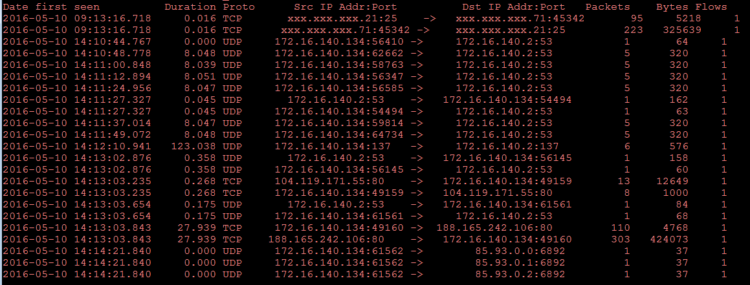
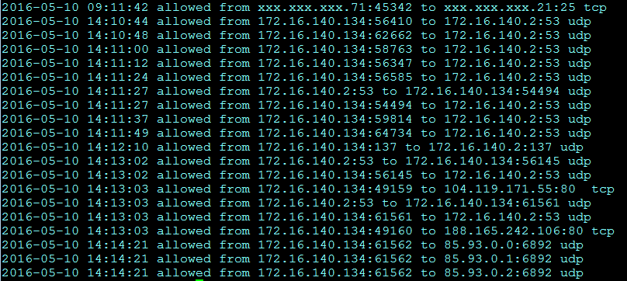
Scenario 1: Flows and Logs
Flows
SMTP – blends in with all corp email (maybe key off of public IP)
HTTP – blends in with all corp web traffic (maybe key off of public IP)
DNS – blends in with all corp dns
C2 (no luck catching delivery/downloader – maybe UDP traffic??)
Firewall/Logs
SMTP – blends in with all corp email (maybe key off of public IP)
HTTP – blends in with all corp web traffic (maybe key off of public IP)
DNS – blends in with all corp dns
C2 (no luck catching delivery/downloader – maybe UDP traffic??)
SMTP
DNS
HTTP
Beacon
DNS
Beacon

Slide 22
Scenario 2: Suspicious Network Traffic
Suspicious traffic over http from several clients to a single IP address
Traffic observed for approx. an hour

Slide 23
Scenario 2: What’s on Your Drive

Slide 24
What’s on Your Drive
(6.122)
(6.917)
(13.766)
(35.714)

Slide 25
Searching over Time
FW
logs
Flows
FPC
Bro
CONTEXT
EASE of SEARCH

Slide 26
Retention over Time
FPC
Bro
FW
logs
Flows
TIME
DISK SPACE

Slide 27
The Pros and Cons Network Capture
 | Easily Searchable | Application Specific | Context Rich | Look back Capability | Scalable Across the Network | Ease of Long-term Storage
FPC | N | N | Y | Y | N | N
Bro | Maybe | N | Y | Y | Y | Y
Netflow | Y | N | N | Y | Y | Y
Proxy/ Gateway Logs | Y | Y | Y | Y | N | Y
NIDS | Y | N | Maybe | N | N | Y
Firewall Logs | Y | N | N | Y | N/A | Y

Slide 28
Introducing Bro
About Bro IDS
Developed by Vern Paxson
20+ years old
IDS but more…
Meta-data all the things
Built on frameworks to digest various areas of network categorization
Rule logic constructed by hooking into “events”
“Bro is not strictly an intrusion detection system that generates alerts, like Snort. Rather, Bro generates a range of NSM data, including session data, transaction data, extracted content data, statistical data, and even alerts -- if you want them.”
- Richard Bejtlich, TaoSecurity
http://taosecurity.blogspot.com/2015/01/try-critical-stack-intel-client.html

Slide 29
Bro Frameworks
Frameworks
File Analysis
GeoLocation
Input
Intelligence
Logging
Notice
Signature
Summary
Broker-Enabled Communication
Source: https://www.bro.org/sphinx/frameworks/index.html

Slide 30
Bro “out of the box”
CUID, FUID
Originator/Responder v. Source/Destination
Client/Server relationship displayed in a unique way
CRgU5K1zEjs97VD90d 172.16.140.134 49159 104.119.171.55 80 GET www.oracle.com /
CRgU5K1zEjs97VD90d 172.16.140.134 49159 104.119.171.55 80 GET www.oracle.com /index.html
C5oKx53ZqYePW3r0Lf 172.16.140.134 49160 188.165.242.106 80 GET pompe-distribution.com
CSfVmG1DYRmTYPkfB8 172.16.140.134 56145 172.16.140.2 53 www.oracle.com A 104.119.171.55... CU0xL93k2TxtBtJ1Gc 172.16.140.134 61561 172.16.140.2 53 pompe-distribution.com A 188.165.242.106
1462886008.279905 C5ouiO24QUYz30Xe8b xxx.xxx.xxx.21 45342 xxx.xxx.xxx.71 25 <gidue@gidue.com> Tue, 10 May 2016 20:11:30 +0700 "Chester Blanchard" <gidue@gidue.com> <20160510131133.5F2884741FA@virt.gidue.com> Chester Blanchard xxx.168.116.60,10.0.0.135,xxx.100.176.110 Opera Mail 6.32.113 FaDVWx4yFrK1oXaLj9,F5z29J21T6RkiBkQYd

Slide 31
Bro: Application Logs
Application specific logs
Connections, dns, http, smtp, oh my…
Wait, ssl?
Did you know…
IRC
Modbus
SOCKS Proxy
Other tunnels

Slide 32
Bro: Tips, Tricks and Automobiles
less –S
Tells less not to wrap the line and allows scrolling across the screen
Essential to viewing Bro logs at the command line
cf, date –d @epoch-time
Translate between epoch time and human-readable
&Redef’s
Command line too?
Can run against saved pcaps (-r option)
dump-events.bro
<bro>/share/bro/policy/misc/dump-events.bro
Essential for writing custom scripts and knowing exactly what Bro knows/sees
##! This script dumps the events that Bro raises out to standard output in a
##! readable form. This is for debugging only and allows to understand events and
##! their parameters as Bro processes input. Note that it will show only events
##! for which a handler is defined.

Slide 33
Bro Scripting
Bro has its own scripting language that allows analysts to write custom logging and alerting scripts
Common networking data points are types in Bro:
addr (IP address: v4, v6)
port (layer-4 port: 22/tcp, 53/udp)
subnet (CIDR subnet mask: 10.0.0.0/8)
Bro’s “Built-In Functions” are commonly referred to as BIFs
https://github.com/bro/cheat-sheet
https://www.bro.org/bro-workshop-2011/exercises/prog-primer/index.html

Slide 34
Presentation Summary
Loss of context over time
Difficult to understand the full picture of an incident without all the data
Time is critical
Need quick and query-able data
All environments are different
Use capture tools and techniques that tailor to your environment

Slide 35

Questions?

